Slide 1
Emotion Classification Model
(Text Classification LLM Fine-tuning)
Stephanie Ekekwe

Slide 2
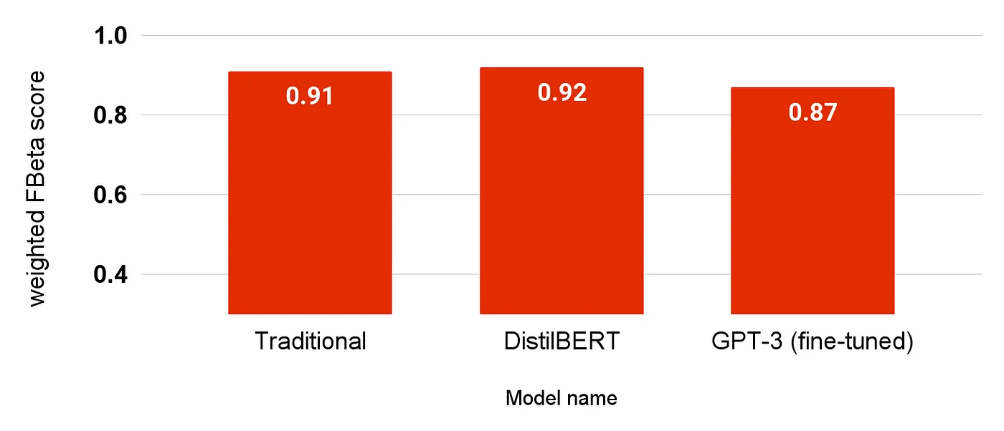

Choosing the Right Model
Objective: Classify emotions from text using the dair-ai/emotion dataset
Chosen Model - DistilBERT-base-uncased
WHY?
Efficiency: Lighter and faster than BERT with minimal performance trade-off.
Performance: Maintains 97% of BERT’s capabilities despite being 40% smaller.
Cost-Effective: Less resource-intensive, ideal for fine-tuning on specific tasks like emotion classification.
DistilBERT's streamlined architecture is well-suited for the structured format of the dair-ai/emotion dataset, allowing efficient training and accurate results and it provides an optimal balance between performance and efficiency, making it an excellent choice for emotion classification tasks.
Image Source: Why Using GPT May Not Be the Best Option for Customer Feedback Classification - by Maarten Sukel

Slide 3
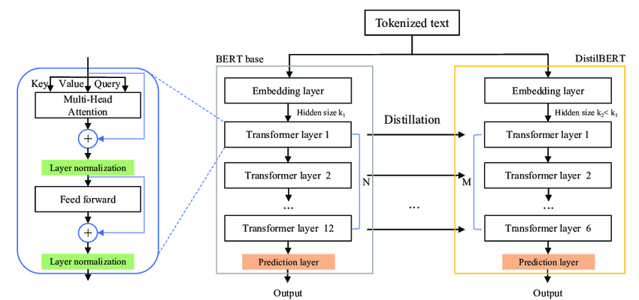
In-Depth Look at Model Infrastructure and Optimization
Model Architecture Overview
Design Philosophy: DistilBERT is designed to provide BERT-level performance with reduced complexity.
Key Features: Includes a Transformer architecture with fewer layers than BERT, maintaining essential features for high performance.
Key Parameters in DistilBERT
Parameters Explained: DistilBERT utilizes parameters such as attention heads, hidden sizes, and intermediate sizes strategically to balance efficiency and performance."
Parameter Efficiency: "Focus on reducing the total number of parameters while preserving the model’s ability to generalize from data."
Optimized architecture and parameters lead to faster training times and lower computational costs. Enhanced with fine-tuning, DistilBERT is robust and ready for real-world applications, such as emotion detection.

Slide 4
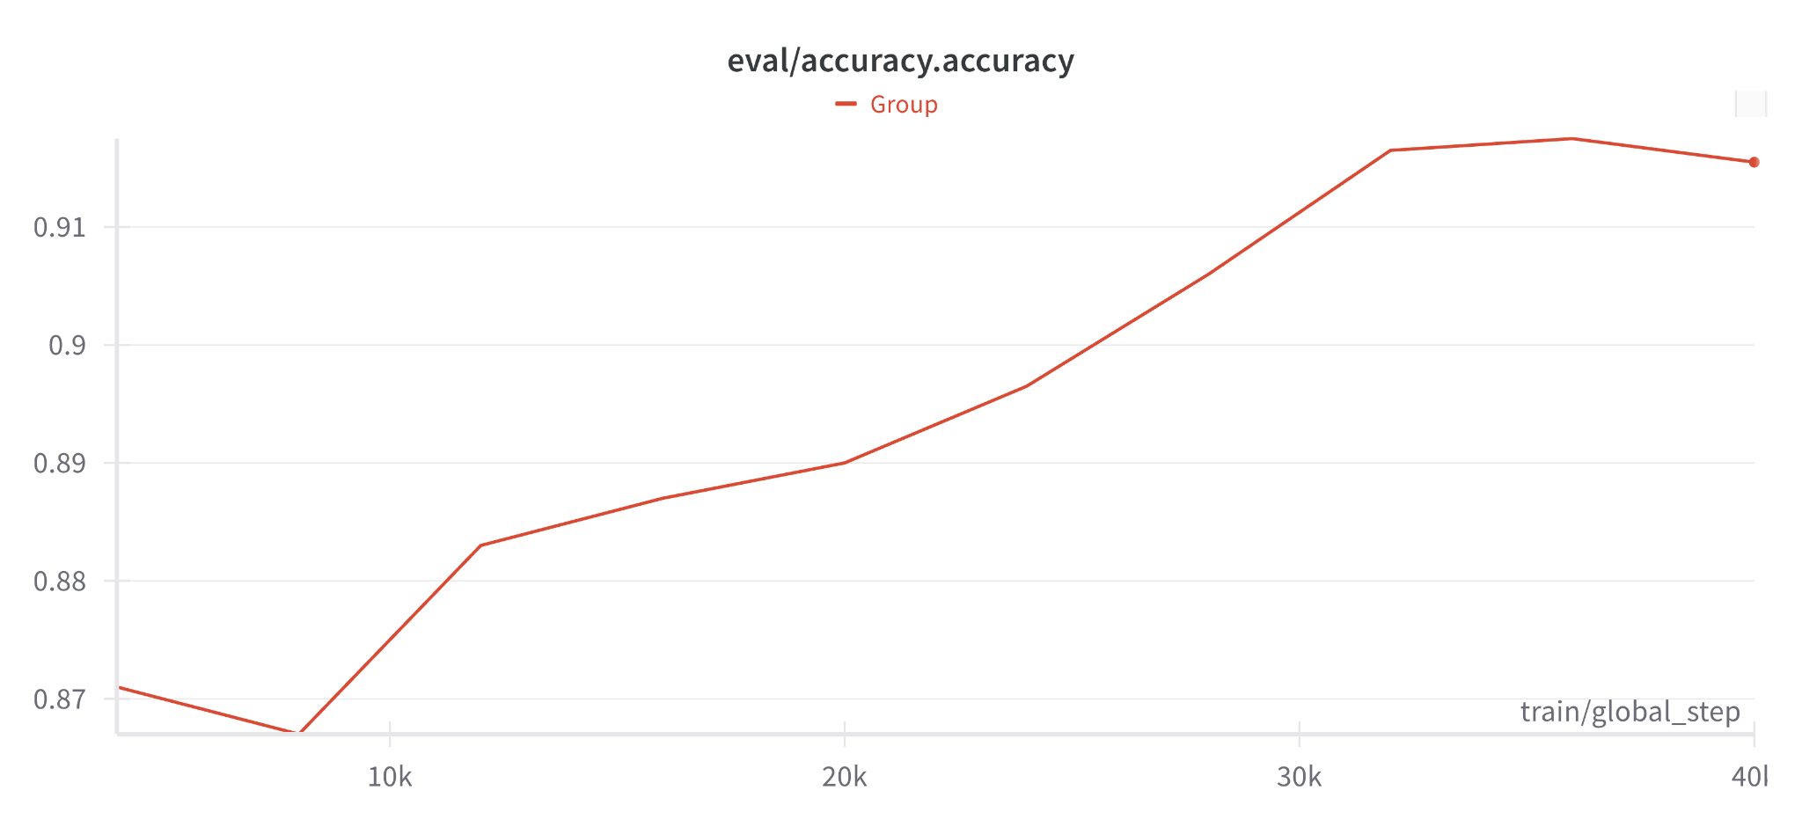
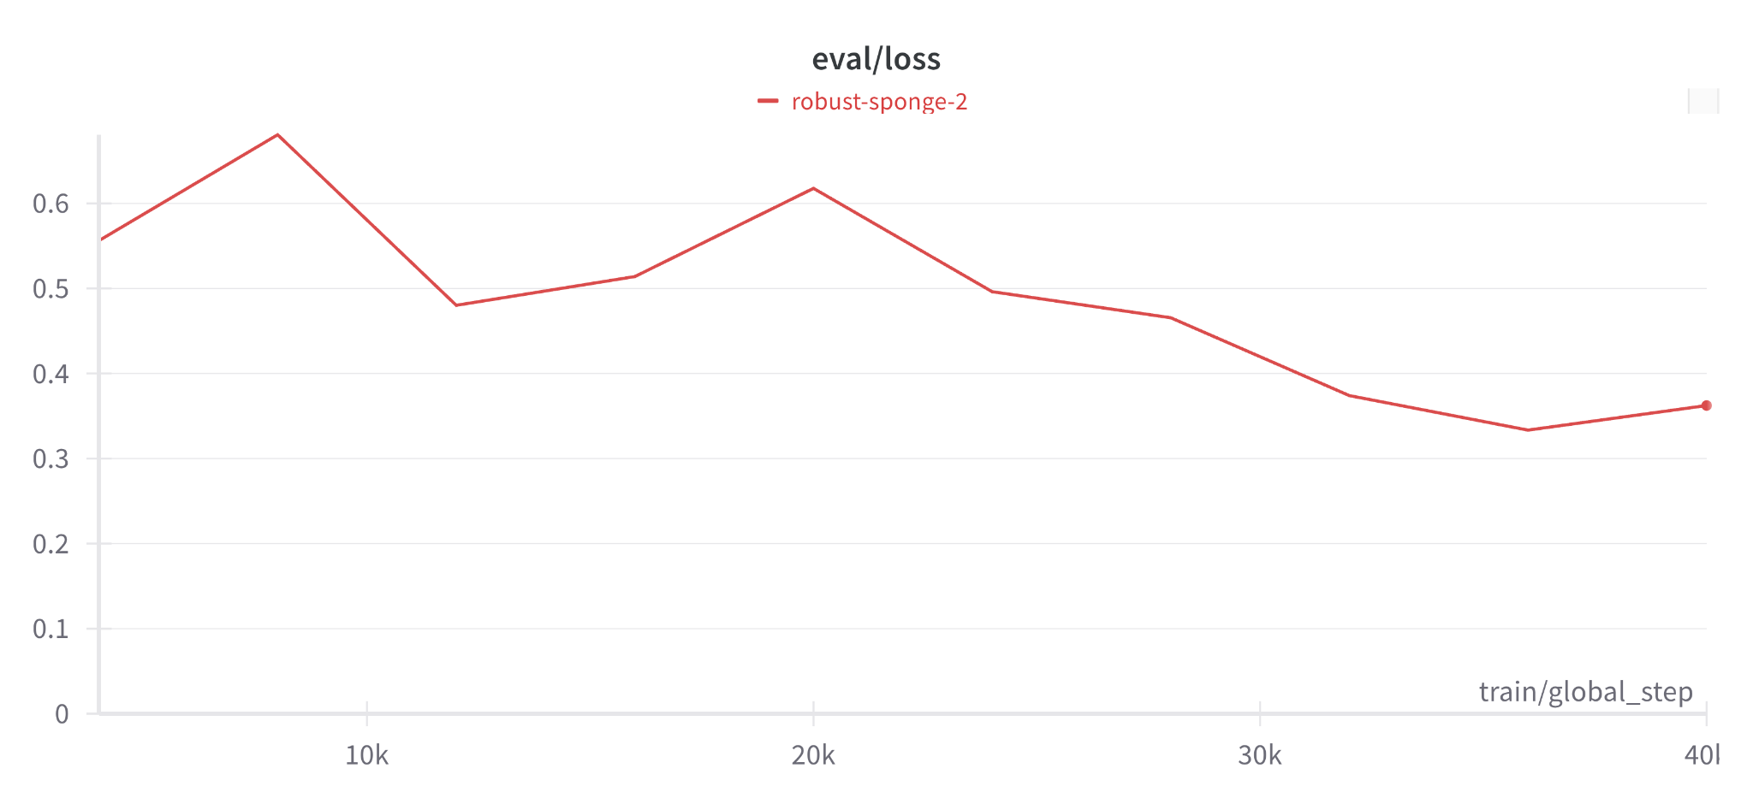
Enhancing Model Performance
Advanced Strategies for Fine-Tuning and Evaluation
Utilizing Hugging Face's Transformers & Pre-trained Tokenizer:
Tokenizer: Adjusted tokenizer handling from a pre-trained model to improve token processing efficiency.
PEFT with LoRA: Implemented Pretrained Efficient Fine-Tuning (PEFT) using LoRA for targeted, efficient parameter updates.
PEFT Configuration for Enhanced Performance:
Task Type: Sequence Classification focused on multi-class scenarios.
LoRA Specifics: Low-rank adaptations (r=4, alpha=32) to refine model learning without extensive parameter growth.
Dropout: Incorporated a 0.01 dropout rate to minimize overfitting.
Effective Fine-Tuning with LoRA using tailored tokenizer settings significantly enhanced the model responsiveness and precision. Using accuracy as a benchmark, we ensure the model meets practical deployment standards.

Slide 5

Model Scalability and Efficiency
Understanding Scalability in Machine Learning Models
Scalability refers to a model's ability to maintain or improve performance as it handles larger and more complex datasets.
Importance: it is Critical for deploying models in varied real-world environments where data volume and complexity can vary greatly.
Optimizing Model Size and Speed with Knowledge Distillation & Fine-Tuning Techniques
Reduces model size and speeds up computation without significant loss in accuracy.
Utilizes LoRA to selectively update model parameters, enhancing specific capabilities. Which Enables the model to adapt quickly to new data with minimal additional training.
Reduces model size and speeds up computation without significant loss in accuracy.

Slide 6
Emotion Classification in Risk Detection and Moderation Frameworks
Content Moderation for Media Platforms
Refining Content Recommendations: By recognizing the emotional nuances present in videos, articles, or music, platforms can empower users by better curating and recommending content that resonates with their desired emotional state."
Preventing Harmful Content Spread: By recognizing and flagging content that elicits powerful negative emotions, media platforms can play a vital role in curbing the spread of unsettling or extremist material.
Social Media Monitoring
Detecting Toxic Behavior: The model's ability to classify emotions expressed in posts or comments and flag potentially harmful content is a powerful tool for preventing cyberbullying, harassment, and the spread of hate speech. By detecting such content early on, we can work together to create a safer, more respectful online community.
Crisis Intervention: By detecting extreme emotions such as distress or fear, we can intervene in a timely manner to provide assistance and support to those who may be expressing suicidal thoughts or threats of violence. This can make a significant difference in someone's life and help them find the hope and help they need.

Slide 7
Thank You

